Slide 1





DeFi Bull
vs
DeFi Bear
Kyle Kistner
Matteo Leibowitz
Andrew Keys
vs.

Slide 2
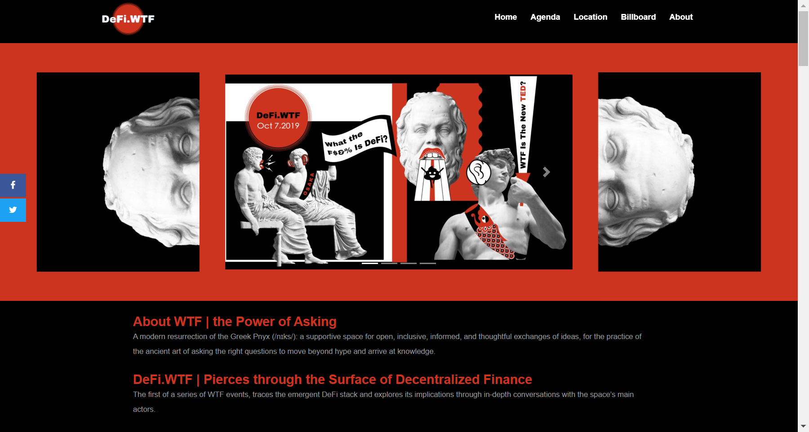

Slide 3
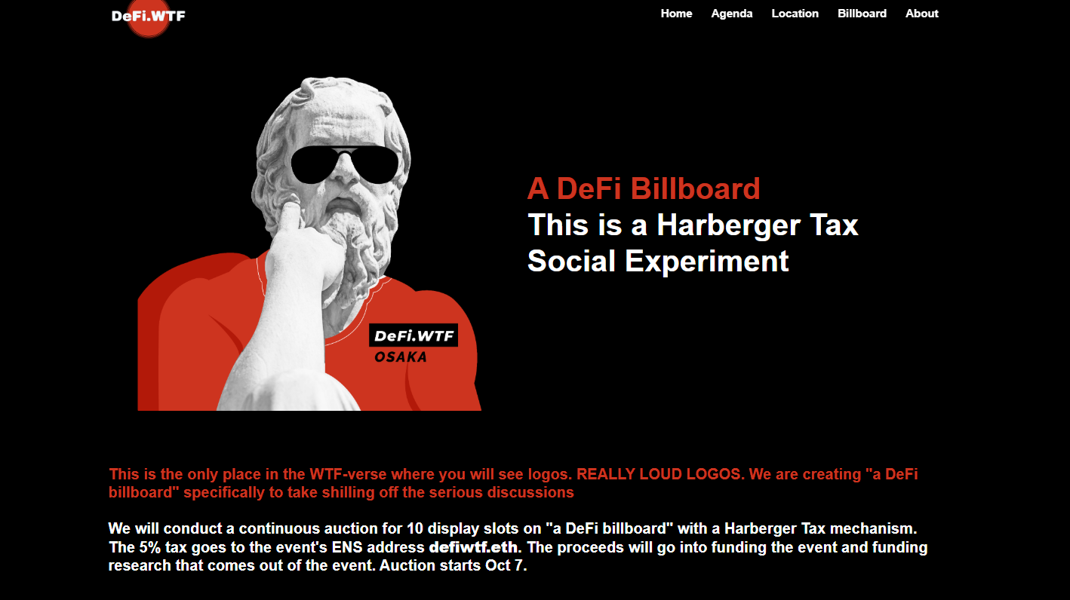

Slide 4

Harberger Tax Social Experiment

